Slide 1
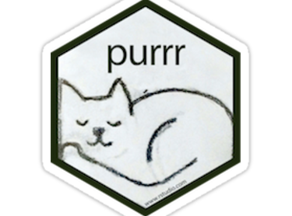
Presentation Two:
purrr package
Madison Roy

Slide 2

Overview
This presentation will include:
Introduction
Why this package?
Installation
Useful purrr functions
Reasons to implement
Limitations
Link to Cheat Sheet
Conclusion

Slide 3
Introduction
As another brainchild from Hadley Wickham, this package is mostly geared towards data wrangling.
This package enhances R’s functional programming toolkit by providing a complete and consistent set of tools for working with functions and vectors.
Makes it easy to apply a function to each item in a list and return results in the format of our choice.
More robust than plyr or base R.

Slide 4
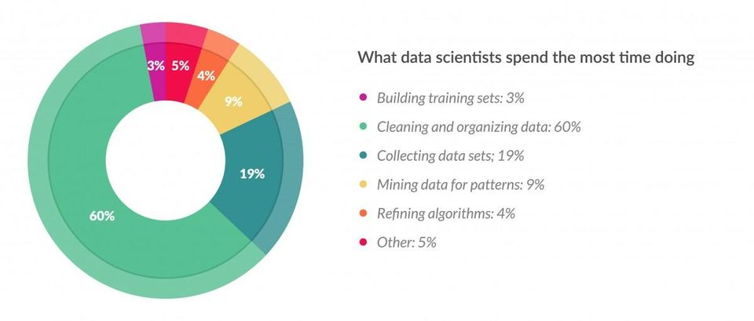
Why this package?
If you are like me, you might be wondering why I chose to present on a package that one can only assume to be named after the sound a cat makes. Well, according to Forbes, data scientists spend about 60% of their time on data cleaning and organizing (which for some projects I think is low-balling it). So, I am hoping to add a few tricks to your tool kit to help make that 60% of your time spent on data wrangling just a little more efficient.

Slide 5

Installation
Just as all other packages we load into R we use the following commands:
install.packages(“purrr”)
library(purr)
Note: Because purrr is a data wrangling package from Hadley Wickham, it can also be installed as part of the tidyverse!

Slide 6
Let’s get into some functions…
The ‘map’ function applies a function iteratively to each element of a list or vector. It requires two arguments:
.x=list or vector
.f=function to apply to each element
Examples:
map(x, is.logical)
map(x, is.na)
Additionally, map2 allows us to apply functions to pairs of elements from two lists.
Examples:
map(x,y, sum)
map(x, y, mean)
map(x, y, std)

Slide 7
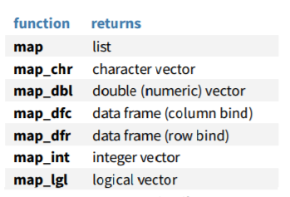
As a default, map and map2 return lists. However, users can use a suffixed version to return results as a specific type of vector instead.
Base R functions lapply, sapply, and mapply will only return lists, so this is an added capability of the purrr package.

Slide 8
Filtering Lists
The ‘pluck’ function selects an element by name or index
  pluck(x, “b”) will return element ‘b’
The ‘keep’ function selects elements that pass a logical test
  keep(x, is.na)
  Alternative method is to evaluate the list first and then have to write another line to grab just the ‘true’ indices.
The ‘discard’ function selects elements that do not pass a logical test
  discard(x, is.na)
  Alternative method is to evaluate the list first and then have to write another line to grab just the ‘false’ indices.
The compact function drops empty elements
  compact(x)
Note: The package also contains numerous functions to summarise lists, however I believe that many of those functions are redundant to other methods in base R or that we have already discussed in this course.

Slide 9
Transforming Lists
The ‘modify’ functions, like map, apply a function to each element. However users can add criteria to filter for just certain observations.
modify_at(.x, .at, .f): Applies function to elements by name or index.
  Ex: modify_at(x, “b”, ~.+2)
modify_if(.x, .p, .f): Applies function to elements that pass a test.
  Ex: modify_if(x, is.numeric, ~.+2)
Note: the ~. syntax takes the place of function(). More succinct coding.

Slide 10
Transforming Lists
continued...
Additional purrr functions that change the shape of lists include:
flatten(): Removes a level of indexes from a lists. Just as with map(), users can specify the return type object.
transpose():Transposes the index order in a multi-level list.
append(): Add to end of list.
preappend(): Add the start of a list.
splice(): Combine objects into a list, storing S3 objects as sub-lists.

Slide 11
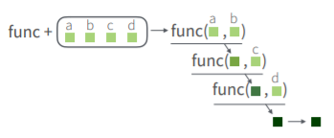
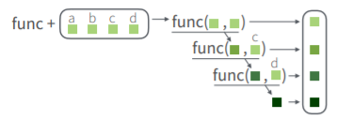
Reducing Lists
reduce(): applies a function recursively to each element of a list or vector.
  Ex: reduce(x, sum)
  No more loops!
accumulate(): reduces, but also return intermediate results. Can be extended to two vectors with accumulate2.
  accumulate(x, sum)
  Still no more loops!

Slide 12
Reasons to Implement
There are many positive aspects to this package such as:
More standardized than base R’s apply functions
User can specify type of returned object
More efficient to run
Condenses multiple lines of code into a single command

Slide 13
Limitations
The biggest limitation of this package, like others as a part of the tidyverse, is that the data need to be in a rectangular structure.
The other limitation of the package is that it is simply not commonly used. So in cases such as ours, we may already have another way to get the same results, though it may not be the quickest way of doing so.

Slide 14
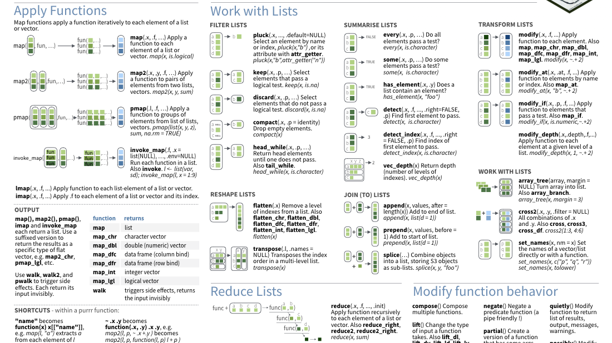
Cheat Sheet!
Just like other data wrangling packages, purrr has an awesome PDF cheat sheet. Click here!

Slide 15
Conclusion
I hope you all learned at least one useful trick from this presentation. Stay safe and healthy!

